Slide 1
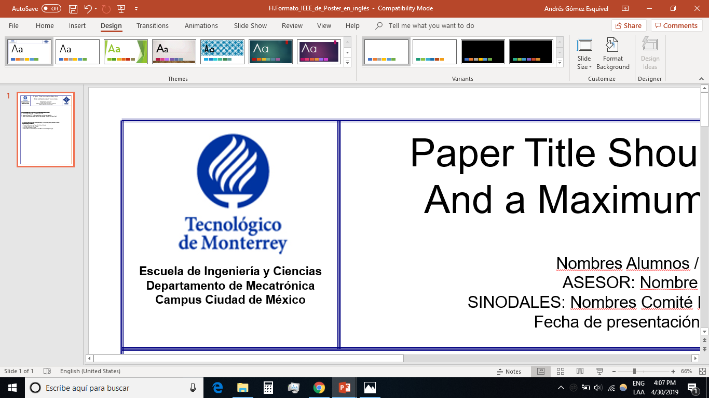

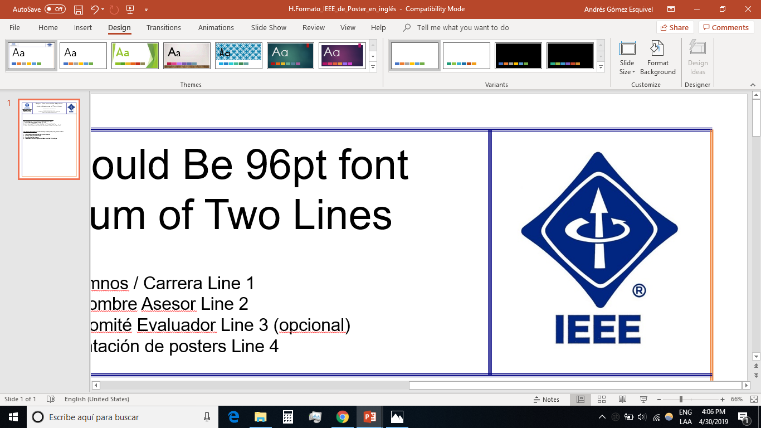
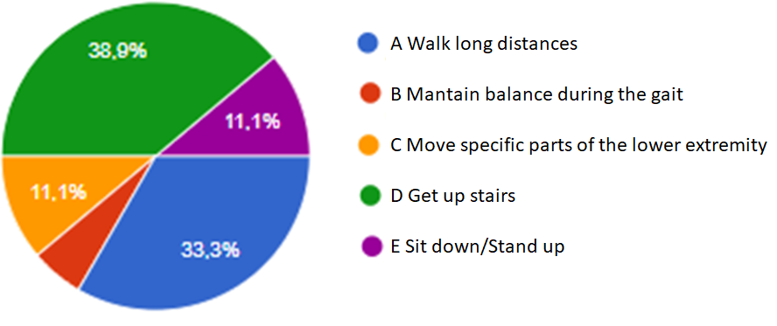
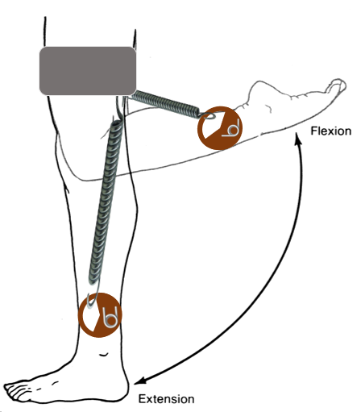
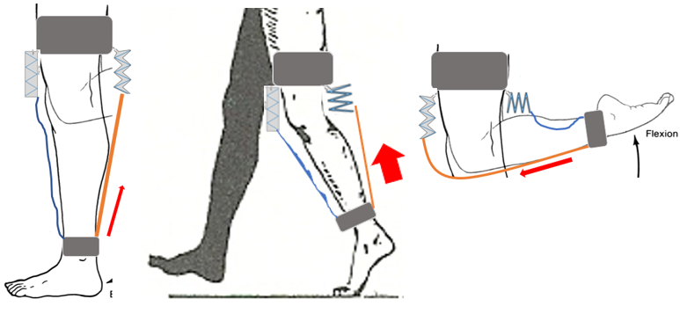
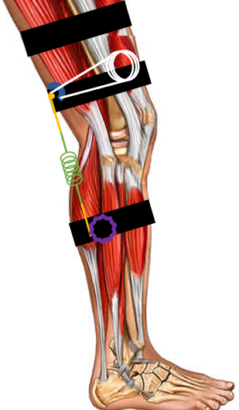
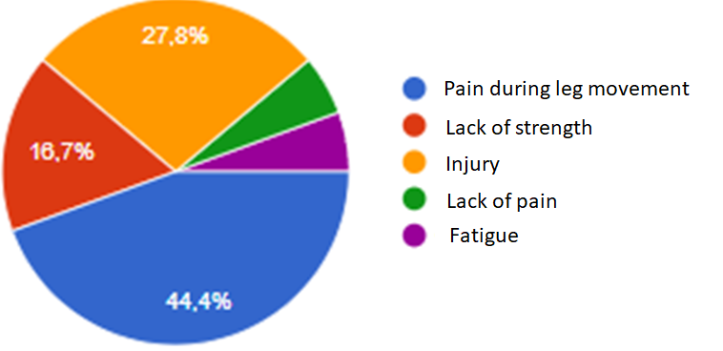
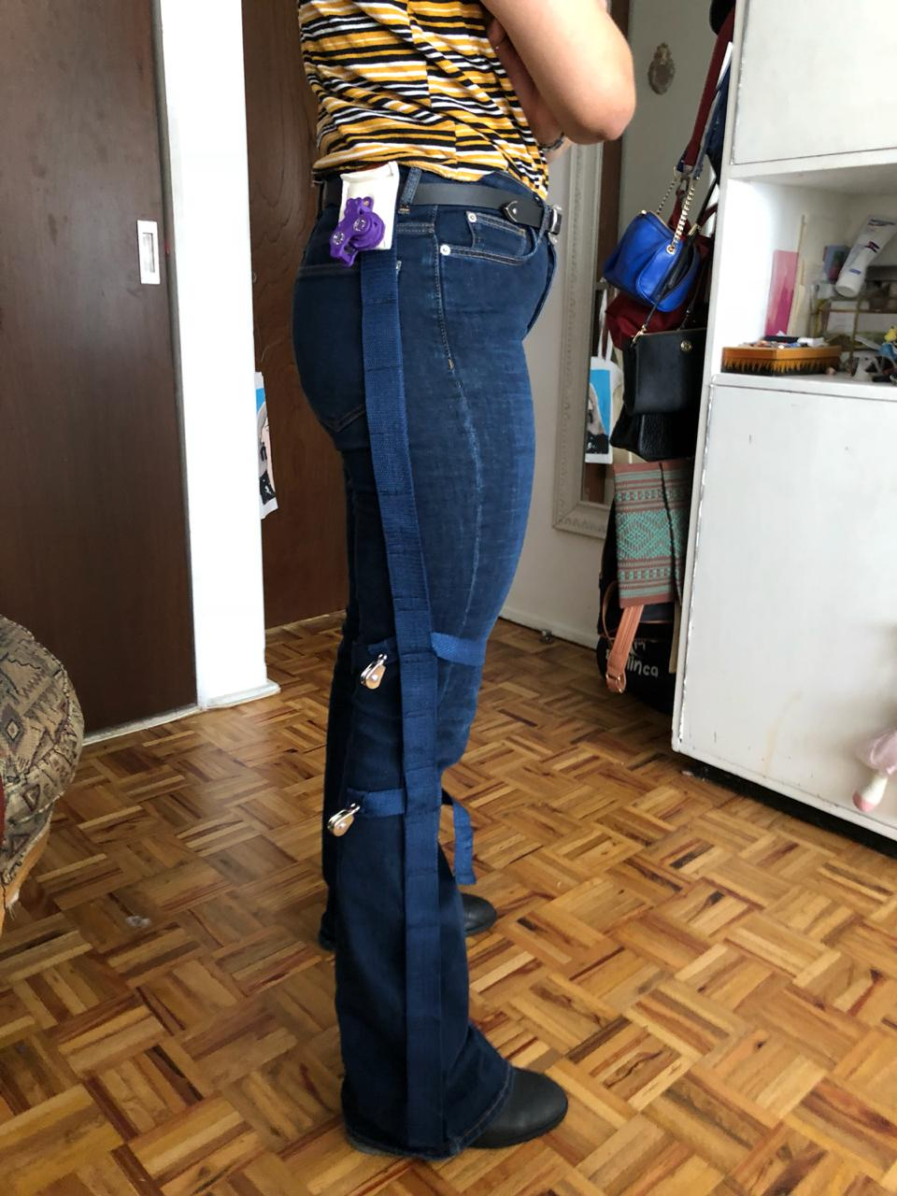
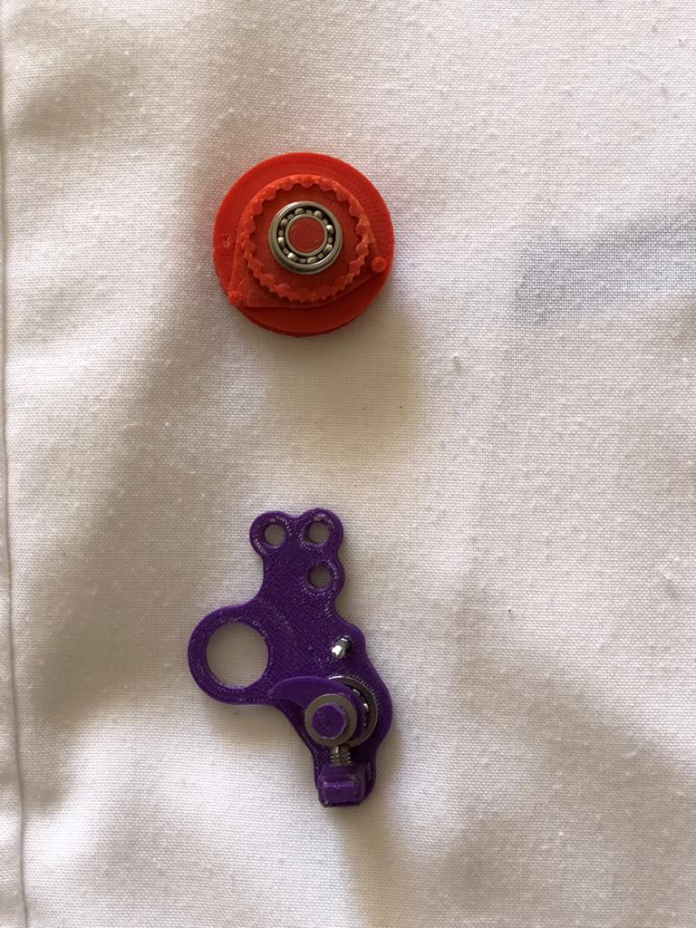
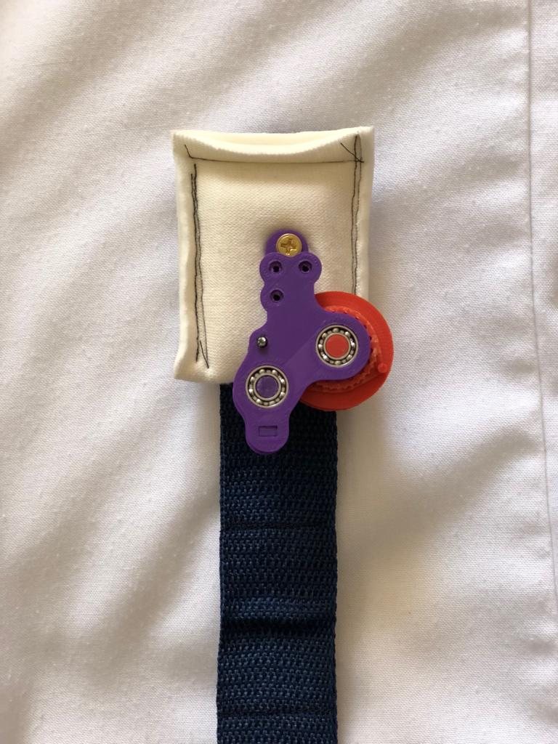
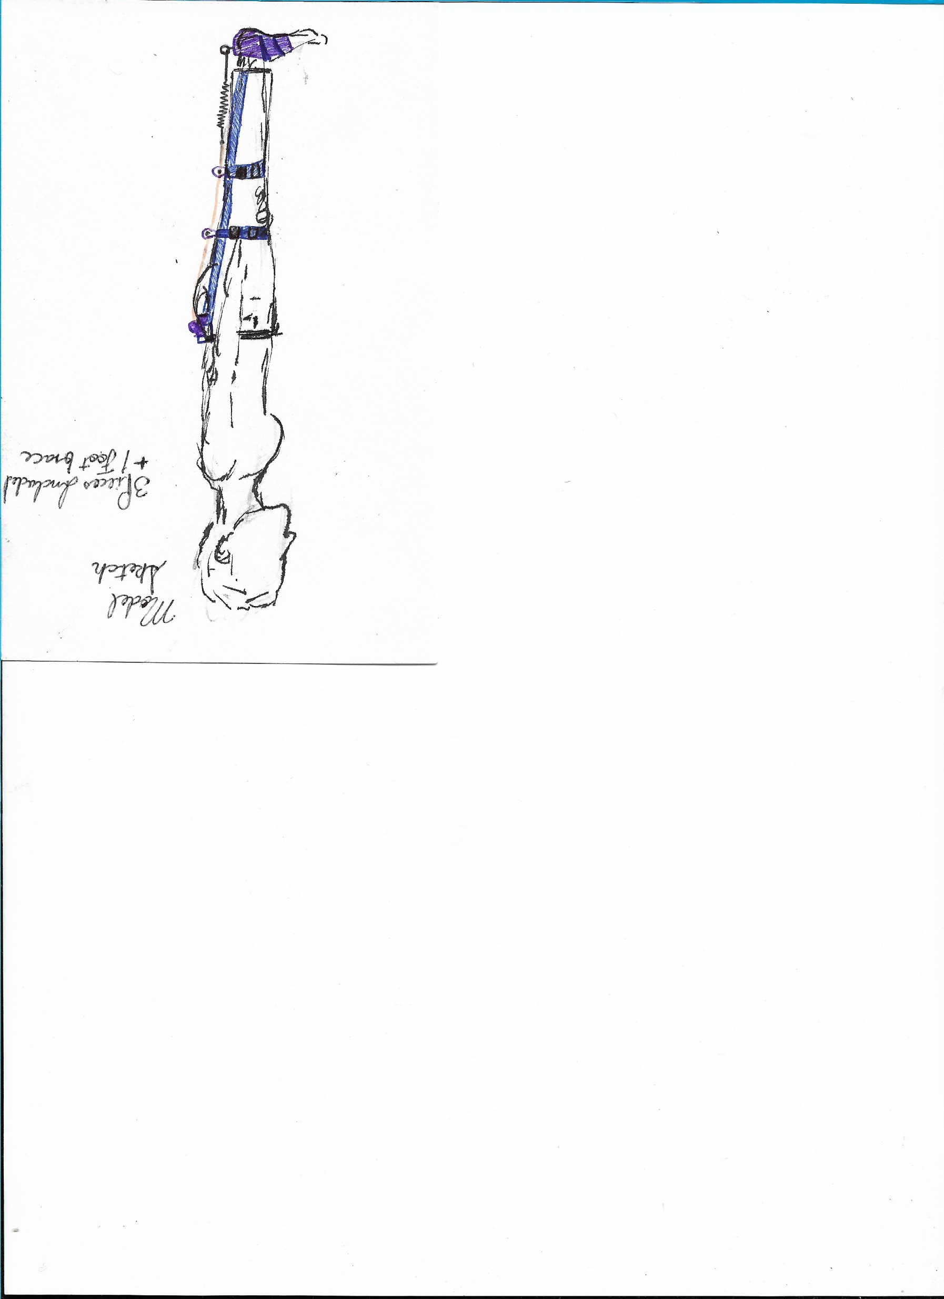
HERMES Exoskeleton
Lower limb exoskeleton for improved
movement in sarcopenia patients
Design in Biomedical Engineering Project
IMD Ma. Fernanda Hdez Mondragón A01650524
IMD Rafael Tinajero Ayala G. A A01650520
IMD Andrés Gómez Esquivel A01332532
Advisors
Dr. Martín Rogelio Bustamante Bello
Ing. Javier Alberto de la Tejera
May 2019
Objectives
General Objective:
Develop an exoskeleton/exosuit through which normal gait can be enhanced and assisted in the case of elderly patients who have struggled with unassisted walking due to muscle weakness caused by sarcopenia.
Specific Objectives:
To create a purely mechanical system which can increase torque in leg joints during normal movement
Designing a light, ergonomic, easy to equip, and affordable system
Creating a highly durable exosuit in order to walk medium to long distances on a regular basis
Problematic
Development
People with gait struggles experience issues with:
Initial Designs
When performing these activities, they feel:
Prototype
Source: Survey conducted on respondents aged 21 to 67
Results
Target populations prefer designs that are soft and easy to manipulate in order to maintain as much as possible their habits and lifestyle.
Physicians claim that the exoskeleton/exosuit mostly needed are those that help with torsion of movement, where the user still needs to execute force, in order to avoid sarcopenia acceleration.
Conclusions
Future Work
Biomechanical analysis shows that a good section of the lower extremities to use as support for the force generation are the hips, reducing the torque required for knee flexion, saving the need for a stronger spring which may cause lesion on the user during knee extension.
Dimensions of suit alongside force exerted by springs should be personalized for each user with a biomechanical analysis of his(her) needs
Outer structure of exoskeleton should be comprised of a slightly rigid yet flexible material in order to allow movement while maintaining intended shape
Perform motion analysis to ensure system does not negatively affect normal gait pattern
Perform force analysis to gauge system effectiveness and energy output by user
Calorimetry Test: Determine the energy consumed during gait using the mechanism in comparison with normal movement , to determine the percentage of energy saved thanks to the prototype.
UPCOMING TEST:
Electromyography Test: Using EMG analyze the muscle leg activity (like leg biceps and semitendinosus muscles) while using the prototype, to ensure the user doesn´t need more muscle activity while using the device.

